Slide 1
Philosophy of Software Freedom

Slide 2
Copyright and Related Rights
Definition of Copyright
Copyright law grants authors, composers, software writers, website designers, and other creators legal protection for their literary and artistic creations, referred to as “works”
Copyright protects a wide variety of original and/or creative expressions, such as novels, poetry, music, paintings, photographs, sculptures, architecture, films, computer programs, video games, original databases, etc.
The rights granted enable the copyright owner, within a specified period of time:
to control the use of his work in a number of ways
to receive remuneration

Slide 3
PART A: BASICS OF COPYRIGHT
Definition of Copyright
Copyright law grants authors, composers, software writers, website designers, and other creators’ legal protection for their literary and artistic creation, referred to as “works”
Copyright protects a wide variety of original and/or creative expressions, such as novels, poetry, music, paintings, photographs, sculptures, architecture, films, computer programs, video games, original databases, etc.
The rights granted enables the copyright owner, within a specified period of time:
to control the use of his work in a number of ways
to receive remuneration

Slide 4
PART A: BASICS OF COPYRIGHT
Requirements for Copyright Protection
To qualify for copyright protection, a work must be original
Originality relates to the expression of thought and not to the underlying idea or thought
Essentially, originality refers to the fact that the work was independently created and it was not copied from somewhere else
Works enjoy copyright protection irrespective of their creative elements, quality or value and do not need to have any literary or artistic merit
Needs to be fixed in material form

Slide 5
PART A: BASICS OF COPYRIGHT
Copyright Protection Abroad – The Berne Convention
Most important international treaty on copyright is the Berne treaty for the protection of literary and artistic works
If you are a national or a resident of a country party to the Berne Convention, your work will automatically enjoy the level of protection granted in the Berne Convention in all countries that are party to the Convention
However, as copyright protection remains territorial, your copyright work has to satisfy the requirements of the copyright law where you seek protection
How many signatories are there to the Berne Convention?

Slide 6
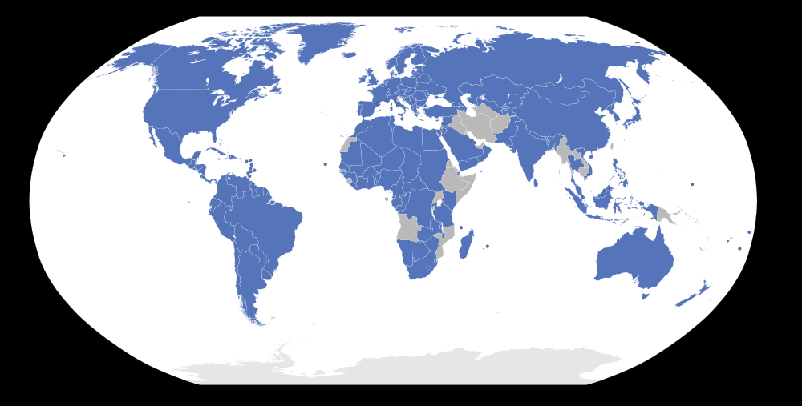
BERNE CONVENTION MEMBERS

Slide 7
PART A: BASICS OF COPYRIGHT
Copyright Notice
There is no formal procedure to put the notice on your work, however it is strongly advisable to remind people that the work is copyrighted and identifies the copyright owner
Assists those who may want to obtain your prior permission
A cheap and cost-effective safeguard
A copyright notice general consists of:
The word “copyright” or the copyright symbol “©”;
The name of the copyright owner;
The year in which the work was first published; and
The words “All Rights Reserved”
Example: © Deepak Pillai 2006 – 2011. All rights reserved

Slide 8
PART B: COPYRIGHT & RELATED RIGHTS
Scope of copyright protection
Basics of related rights
Period of protection

Slide 9
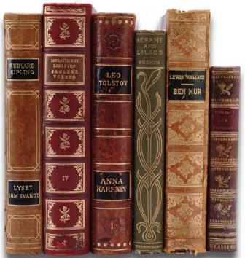
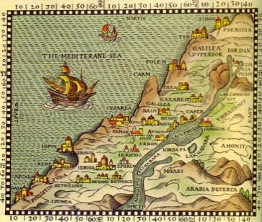
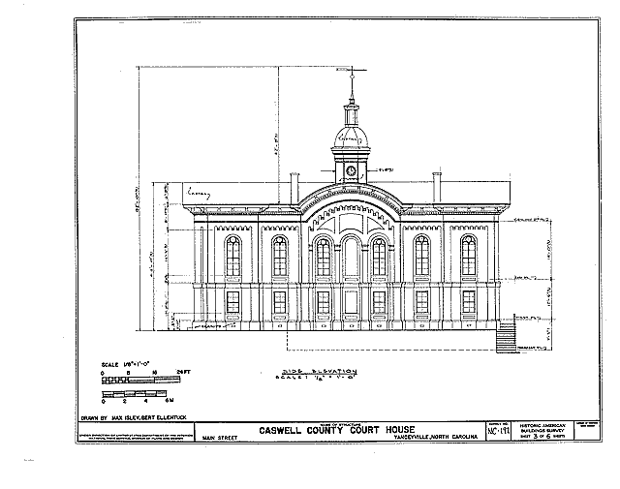
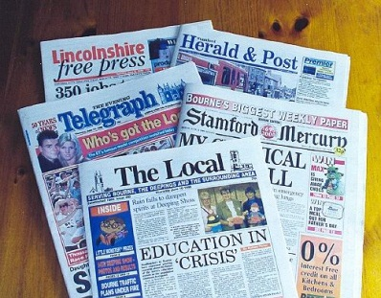

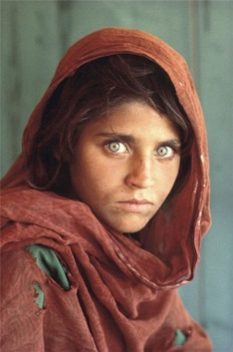

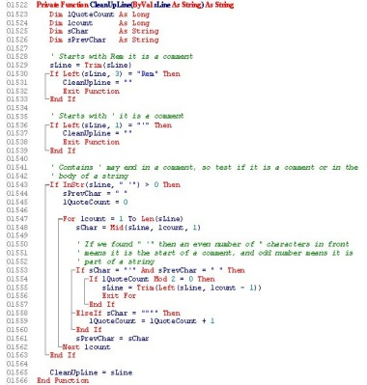

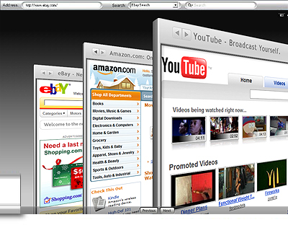
Books And Other Written Materials

Slide 10
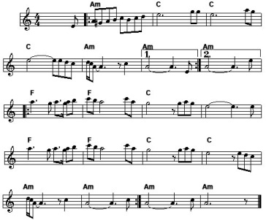
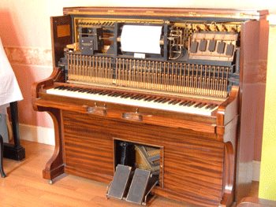

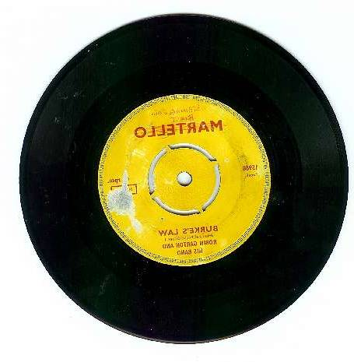
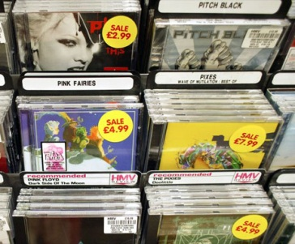
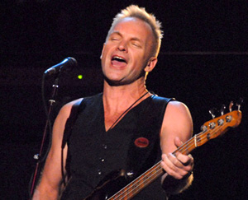
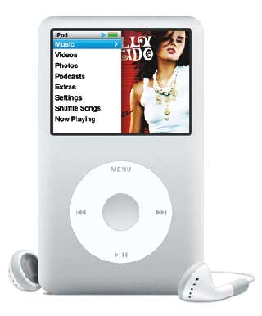



Music

Slide 11
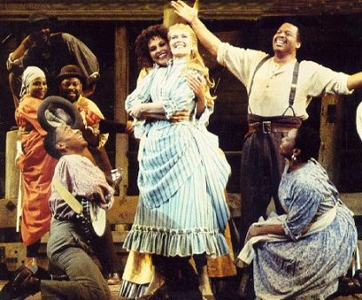
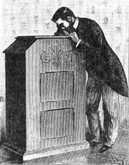
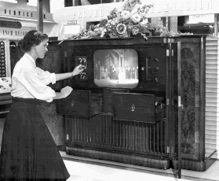
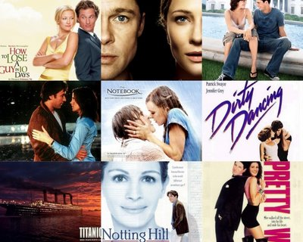
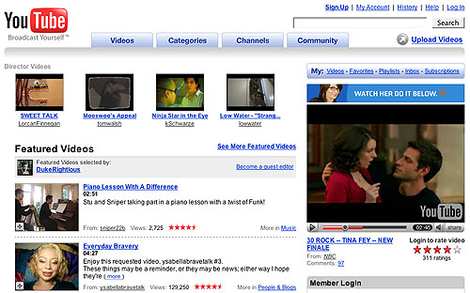

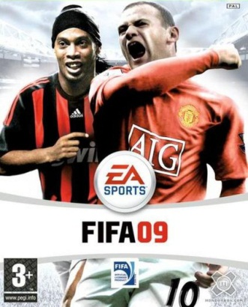

Television, Movies & Games

Slide 12
PART B: COPYRIGHT & RELATED RIGHTS
Scope of Copyright Protection
Works Protected by Copyright
Literary works (books, written speeches, magazines, newsletters, trade journals, training materials, technical papers, instruction manuals, catalogues);
Musical works (songs, operas and musicals);
Dramatic works (dance, plays, mime);
Artistic works (cartoons, paintings, sculptures, architectural works, blueprints, computer and laser artwork);
Photographic works (such as photos, engravings);
Computer programs, software, and original databases;
Maps, globes, charts, diagrams and technical drawings;

Slide 13
PART B: COPYRIGHT & RELATED RIGHTS
Scope of Copyright Protection
Works Protected by Copyright (Continued)
Advertisements, commercial prints and labels;
Motion pictures (films, documentaries, television advertisements);
Multimedia products (work combined text with usual images, sound and computer programs, such as video games); and
Works of applied art (artistic jewellery, wallpaper, carpets.)
Note:
Works are protected irrespective whether they are made available on computer diskettes, hard drives, CD-ROMs, VCDs, DVDs, or whether they are transmitted by radio stations, television stations or downloaded via the Internet

Slide 14
PART B: COPYRIGHT & RELATED RIGHTS
Scope of Copyright Protection - The things copyright does not protect
Ideas
Copyright law only protects the way ideas are expressed in a particular creation
Copyright does not protect the underlying idea, procedure, method of operation, mathematical concept or system
Ideas protected under patent law or as trade secrets
Facts
Copyright does not protect facts – whether scientific, historical, biographical or news of the day
Only the manner in which such facts are expressed, selected or arranged are protected
Others are free to use the facts as long as they do not copy the manner in which the facts are expressed

Slide 15
PART B: COPYRIGHT & RELATED RIGHTS
Scope of Copyright Protection - The things copyright does not protect
Useful articles
Copyright protection may not available for articles registered or protectable under industrial design law
Usually the design of a useful article may be protected as an industrial design while copyright protection may apply to the pictorial, graphic or sculptural features on the object
Names, titles, slogans and other short phrases
Generally not protected under copyright other than for logos
Official government works
Official texts of the Government or statutory bodies of a legislative or regulatory nature, or judicial decisions
Note that this exclusion does not extend to works made by or under the direction or control of the Government or its Government organizations

Slide 16
PART B: COPYRIGHT & RELATED RIGHTS
Scope of Copyright Protection - Economic Rights
Economic rights protect the author’s economic interests and allow the author to earn a profit by direct or indirect exploitation of a work
Scope of these rights and limitations and exceptions, differ on the type of work and from country to country
Generally it includes the exclusive rights to:
Make reproductions or copies of the work in various forms
Distribute the work to the public
Rent or lend copies of the work
Make translations or adaptations of the work
Communicate the work to the public
Perform, show or play the work in public

Slide 17
PART B: COPYRIGHT & RELATED RIGHTS
Scope of Copyright Protection - Moral Rights
Most countries recognize moral rights, albeit the scope may vary from country to country
Generally, all countries recognize two types of moral rights:
The right to be named as the author of the work (‘authorship right” or “paternity right”)
The right to protect the integrity of the work e.g. it prohibits any changes, modifications or alterations to a work that would damage the author’s honour or reputation
Moral rights cannot be transferred to someone else
Moral rights may be waived by the author in some countries by way of a written agreement, for a specified period of time.

Slide 18
PART B: COPYRIGHT & RELATED RIGHTS
Copyright vs. Related Rights
Copyright and related rights complement each other by protecting different people’s involvement in a particular work
While copyright protects the author, related rights are rights granted to others who are involved in making the work public
For example, in the case of a song, whilst copyright protects the composer’s music and songwriter’s lyrics, related rights would protect:
singers and musicians who perform the song;
producer(s) have made a sound recording of the song; and
broadcasters that produced the broadcast program (Radio, TV & Web) in which the song was broadcast

Slide 19
PART B: COPYRIGHT & RELATED RIGHTS
Definition of Related Rights
There are three kinds of “related rights” or “neighbouring rights”:
rights of performers (actors, musicians, singers, dancers or generally people who perform) in their performances;
rights of producers of sound recordings in their recordings (cassette recordings, compact discs, etc.); and
rights of broadcasting organizations in their radio and television programs and in internet broadcasts such as ‘podcasts’

Slide 20
PART B: COPYRIGHT & RELATED RIGHTS
What are the rights that they have?
Performers
You need to obtain the consent of the performer prior to recording, broadcasting or delivering a live performance by cable as well as reproducing recordings
Producers of sound recordings
They have a legal right in their recordings and have the right to take action against unauthorized copying, use or distribution
Broadcasters
They enjoy the right to control the rebroadcasting, fixation (recording) and reproduction of their broadcasts
The protection offered by related rights is independent of any copyright protection that may exist in the works being performed, recorded or broadcast

Slide 21
PART B: COPYRIGHT & RELATED RIGHTS
Period of Protection
A work is automatically protected as soon as it exists, without any special registration, deposit, payment of fee or any other formal or administrative requirement
There are variations, e.g. USA
For most countries, protection of the economic rights lasts for the lifetime of the author plus an additional period of at least 50 years (in the US and Europe, 70 years after death)
Not only the author benefits, but his or her heirs too
If several authors are involved (work of joint authorship) then the term of protection is calculated from the death of the last surviving author
Generally in Malaysia, copyright & related rights last for a period of 50 years after the first performance, date of publishing, recording (sound), or broadcast
i.e. there does not seem to be much of a distinction
Upon expiry of copyright, work will be in the public domain

Slide 22
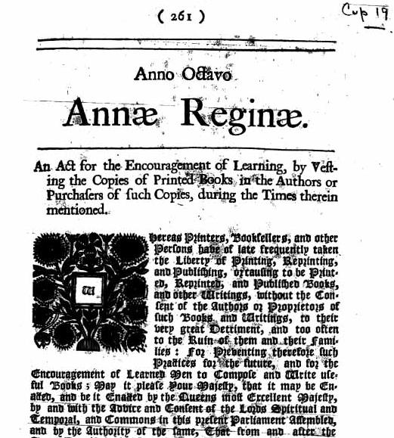
PART B: COPYRIGHT & RELATED RIGHTS
Rationale of Copyright Protection
Term of protection for copyright is relatively long in comparison with other IP
The intention is to allow creators of original work sufficient time to receive due compensation for their intellectual efforts
Rationale behind copyright is to promote the progress of science and arts by encouraging the creation of new works by
guaranteeing some exclusivity for a limited time
following which the works will return to the public domain for others to benefit from them e.g. for other to incorporate old ideas with the new
Protection has evolved over the past three centuries, i.e. from 1709, and will continue to do so

Slide 23
PART C: OWNERSHIP OF COPYRIGHT
Meaning of ownership of copyright
In case of commissioned works
In case of works created by an employee
In case of works created by several authors

Slide 24
PART C: OWNERSHIP OF COPYRIGHT
Meaning of Ownership of Copyright
Terms “authorship” and “ownership” are often confused
“Author” refers to the person who created the work as opposed to someone who contributed the idea of the work
The “owner” of the copyright in a work is the person who has the exclusive rights to exploit the work e.g. to use, copy, sell and make derivative works.
Generally, copyright in a work initially belongs to the person who actually created it i.e. the author, which will then be automatically transferred to the owner in the following scenarios:
if the work was created by an employee as part of his job
if the work was commissioned or specially ordered

Slide 25
PART C: OWNERSHIP OF COPYRIGHT
Who owns the copyright in commissioned works?
In Malaysia, by virtue of Section 26(2) of the Copyright 1987, the copyright to a commissioned work is deemed to be transferred, in the absence of any agreement to the contrary, from the author to the person who commissioned the work
Default position, e.g. where there is no contract or only a P.O.
Terms can be varied by way of contract
Important to examine all contracts for the creation of IP for this element
In most other countries, the creator owns the copyright in the commissioned work, while the person who commissioned it merely has a license to use
Need to be carful when going abroad
Good idea to address copyright ownership issues in an agreement prior to commissioning the external services

Slide 26
PART C: OWNERSHIP OF COPYRIGHT
Entering into a Copyright and License / Assignment Agreements
Before entering into a relationship involving the creation of a work, ensure that you are clear on
What rights you own in the work under the law, e.g. what are you contributing to the work
Whether you need to own the copyright in the work
Whether a license to the work would be more appropriate
Points to consider include:
Whether or not you want to prevent unauthorized use
Whether or not you want to license the work to others
Whether or not you want to re-use the work for other purposes in the future
How much you want to pay to the author of the work

Slide 27
PART C: OWNERSHIP OF COPYRIGHT
To ensure ownership of copyright, you may do the following:
Sign a written agreement with the author of the work, specifically acknowledging that copyright is transferred
Not needed bearing in mind the default position in S. 26(2) of the Copyright Act 1987
Alternatively, you may agree to licensing the right to use with some type of moratorium
Depending on where you are, consider the necessity of obtaining:
Confirmatory assignment documents immediately after completion of the work, specifically naming the copyright work by title
A waiver of moral rights
Registering the work with the national copyright office (If available)

Slide 28
PART C: OWNERSHIP OF COPYRIGHT
Who owns the copyright in works created by employees?
In Malaysia (as well as some other countries), if a work was created by an employee within a scope of his/her employment, then the employer automatically owns the copyright
unless otherwise agreed in the employment agreement or any other supplementary documents
Disputes may arise where the employee does work after hours and/or produces work not within the scope of the employee's ordinary employment
Good practice to have employees sign a written agreement that clearly addresses all the relevant copyright issues prior to commencement of work

Slide 29
PART C: OWNERSHIP OF COPYRIGHT
Who owns the copyright in the works created by several authors?
Joint Ownership
Means a work produced by the collaboration of two or more authors in which the contribution of each author is not separable from the contribution of the other author or authors
Ideally, the rights should be exercised on the basis of an agreement between the co-authors
To be avoided as far as reasonably possible, as:
Any one of the joint owners can exploit the work without permission of the other co‐author(s) (but must share the profits generated from such use)
In other jurisdictions, the consent of all joint owners is needed before copyright can be exercised

Slide 30
PART C: OWNERSHIP OF COPYRIGHT
Collective works
If the authors do not intend the work to be a joint work and would like their contributions to be used separately, then the work will be deemed to be “collective”
In this case, each author owns the copyright in the part he/she created
Derivative works
A derivative work is a work based on one or more pre-existing works, such as translation, musical arrangement, dramatization or motion picture version of a novel
Making derivative works is an exclusive right of the copyright owner
Therefore, if the original work is protected by copyright, you cannot prepare a derivative work without the copyright owner’s permission
Please note that the Act states that a work shall not be ineligible for copyright by reason only that the making of the work, or the doing of any act in relation to the work involves an infringement of copyright in some other work
Copyright extends only to those aspects which are original to the derivative work

Slide 31
PART C: OWNERSHIP OF COPYRIGHT
Copyright Infringement
Infringement of your economic rights may occur when someone, without authorization is:
doing an act that you alone have the exclusive right to do (e.g. making copies of your copyrighted works);
dealing commercially with an infringing work (e.g., selling a pirate CD); or
importing an infringing work
using a part of your work without authorisation
Moral rights may be infringed if the following occurs:
if your contribution, as author of the work, is not recognized;
if the copier passes himself off as the author of the work; or
if your work is subjected to derogatory treatment or is cut or modified in a way that would be prejudicial to your honour or reputation

Slide 32
PART C: OWNERSHIP OF COPYRIGHT
There are a few ways how you can commercialize your original and/or creative works:
you may sell the original works that are protected by copyright
you may make copies or reproductions and sell the copies
you may allow someone else to reproduce or otherwise use the works through licensing
you may also sell (assign) your copyright over the works, either entirely or partly
There are many models to choose from, depending on what it is that you intend to achieve for your business

Slide 33
PART D: USING WORKS OWNED BY OTHERS
When do you need permission?
When you don’t need permission?
Process to get authorisation
How to reduce the risk of infringement

Slide 34
PART D: USING WORKS OWNED BY OTHERS
When permission is needed
The use or exploitation of any works owned by others requires the copyright owner’s permission
e.g. the use of photographs on your website, the playing of the radio for the benefit of your customers
Even usage of a part of a work will require the owners consent
The best way to avoid infringement is by obtaining express written permission of the copyright owner before you use or exploit the work
It is best to seek expert advice before negotiating terms and conditions of the licensing arrangement with the owner of the copyright

Slide 35
PART D: USING WORKS OWNED BY OTHERS
When permission is not needed
The content or material is not protected under copyright law
e.g. if you are using facts or ideas and not the author’s expression
The work is in the public domain
The copyright on the work has expired
The content or material is covered by the concepts of
‘fair use’ or ‘fair dealing’
limitation or exception under law

Slide 36
PART D: USING WORKS OWNED BY OTHERS
How to Get Authorization
An effective way to obtain authorization is to find out if there is a collective management organization which provides licenses for the use of a particular copyright work
For other types of copyright work, you may need to contact the person named in the copyright notice, which may change over the years
Once you have identified the copyright owner(s) and related rights owners (if any), you will have to negotiate the terms and conditions of the licensing agreement

Slide 37
PART D: USING WORKS OWNED BY OTHERS
Reducing the risk of infringement
Educate employees so that they are aware of possible copyright implications of their work and of others’ rights
Obtain written permission, licenses or assignments, where needed, and ensure employees are familiar with the scope of these permissions, licenses or assignments
Mark any apparatus that could be used to infringe copyright with a clear notice that the apparatus must not be used to infringe copyright
Prohibit employees explicitly from downloading music, video films, etc. from the Internet on office computers
Read agreements and notices regarding copyright works meticulously
Appoint experts for professional advice

Slide 38
PART D: USING WORKS OWNED BY OTHERS
Fair Dealing
Copyright laws in most countries provide for several limitations and exceptions wherein copyright work can be used, either for a fee, free and/or with or without the permission of the owner; for example:
Private study, non-profit research, criticism , review and reporting of current events;
Doing the above acts by way of parody, pastiche or caricature;
Use of a work for the purposes of examination questions;
Reading or recitation in public of any reasonable extract from a published work accompanied by sufficient acknowledgment
Use of any work under the direction of governmental bodies where such use is in the public interest and no profit is derived from it

Slide 39
PART D: USING WORKS OWNED BY OTHERS
Fair Dealing (Continued)
Performance of a work by a non-profit institution for charitable or educational purposes, where no admission fee is charged in respect of such performance
Any use of a work for the purposes of any judicial proceedings, the proceedings of a royal commission, a legislative body, statutory or Governmental inquiry, or of any report of any such proceedings, or for the purpose of the giving of professional advice by a legal practitioner
Making of quotations from a published work if they are compatible with fair practice and their extent does not exceed that justified by the purpose
The abovesaid exceptions are subject to certain qualifying acts, e.g.
the mention of the source of reference and the name of the author and/or owner of the copyright

Slide 40
Q1. Identify the incorrect statement
Copyright grants authors, composers, artists and other creators legal protection for their literary, artistic, dramatic and other types of creations.
Copyright usually protects not only works that are expressed in print, but also works that are created or stored in electronic or digital media.
Copyright protects not only the way in which an idea is expressed, but also the underlying ideas or concepts in a particular creation.
Unlike most other IP rights where registration is required, copyright and related rights protection is available as soon as a work comes into existence.

Slide 41
Q2. Identify the incorrect statement:
Copyright protects works of authors, whereas related rights are granted to a few categories of people for their important role in communicating and disseminating some types of works to the public.
There are three kinds of related rights; rights of performers in their performances, rights of producers of sound recordings in their recordings, and rights of broadcasters in their broadcasts.
The right of the producer of a sound recording is separate from and additional to the copyright in the underlying composition. So, when reproducing a sound recording there may be several different rights to consider.
The copyright of the work created by an employee is automatically owned by the employer.

Slide 42
Q3. Identify the incorrect statement:
If a work was created in the course of a commission contract, the person who ordered the work will have a license to use the work for any purpose he/she wants.
To qualify for copyright protection, it must be original work which is developed independently irrespectively of artistic quality or value.
Copyright provides both economic rights and moral rights. The economic rights protect the author's economic interests and the moral rights protect the creator's creative integrity and reputation.
In most countries, protection of the economic rights lasts for the lifetime of the creator plus an additional period of at least fifty years.

Slide 43
PUBLIC DOMAIN
Subject matter not protected by copyright
Works whose term of protection has expired
Works in which the author has waived his rights (e.g. CC0 1.0 Universal*)
* A CC0 1.0 license indicates that one dedicates his/her work to the public domain by waiving all of his or her rights to the work worldwide under copyright law, including all related and neighboring rights, to the extent allowed by law.

Slide 44
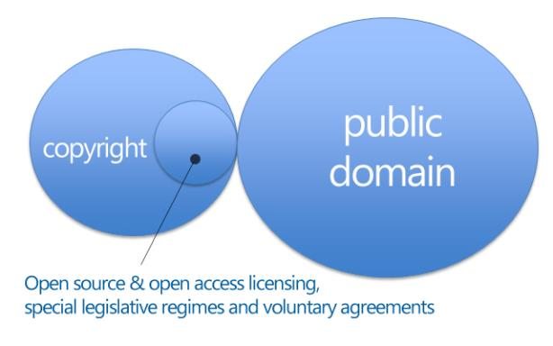
In schemas…

Slide 45
Some observations…
The scope of copyright protection varies between the different jurisdictions (e.g. eligible subject matter, originality, term of protection, etc.)
That has also effect on the scope of the public domain

Slide 46
Free/Open Source Software and the 4 essential freedoms
Freedom to Run
Anyone for any purpose
Freedom to Study
Access to see and modify source code
Freedom to Redistribute
Share binaries and source code
Freedom to Improve
Make it better for the whole community

Slide 47
Differences with proprietary software
Proprietary software:
all rights reserved
author/rightholder identified
source code not distributed
Open source software:
limited rights reserved
authorship fluid/collaborative
source code distributed

Slide 48
Creative commons
Copyright licenses released under this label aim at providing a simple, standardized way to give the public permission to share and use the creative work made available under them.
CC licenses are rooted in copyright. They are not an alternative to it. They work alongside to it. If a user does not respect their terms and conditions, the user is liable under copyright law and is considered to be an infringer. CC licenses aim at simplifying (by classifying and standardizing) terms of use and at allowing to share and use copyright material such as images, films, video, music, writings or any other copyright work on the basis of the license’s conditions.
So, instead of “all rights reserved” CC licenses provide for “some rights reserved”.
Source: <https://creativecommons.org/about/>

Slide 49
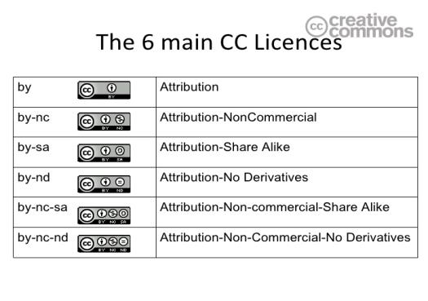

Slide 50
Open access to scientific publications
See the Berlin Declaration on Open Access to Knowledge in the Sciences and Humanities 22.10.2013
It requires authors associated with the signatories to grant to all users free worldwide access (including unrestricted distribution, interoperability and long term archiving) to their works by depositing them in at least one open access repository and publish them in open access journals when available.
Source: <http://openaccess.mpg.de/Berlin-Declaration>

Slide 51
Orphan works
The EU Directive 2012/28 has introduced common rules on the digitisation and online display of ‘orphan works’.
Orphan works are works like books, newspaper and magazine articles and films that are still protected by copyright but whose authors or other rightholders are not known or cannot be located or contacted to obtain copyright permissions.
Source: <http://ec.europa.eu/internal_market/copyright/orphan_works/index_en.htm>

Slide 52
Out-of-Commerce Works
E.g. EU MoU on Key Principles on the Digitisation and Making Available of Out-of-Commerce Worksbetween between representatives of the rightholders’ community (publishers and authors), libraries and collecting societies
Aim:
facilitate the digitisation and making available by European libraries and similar institutions of books and learned journals in their collections which are out-of-commerce.
serve as a blueprint for collective licensing agreements negotiated amongst rightholders, libraries and collecting societies.
Source: <http://ec.europa.eu/internal_market/copyright/out-of-commerce/index_en.htm>

Slide 53
Public Sector Information
E.g. The EU Directive on the re-use of public sector information (Directive 2003/98/EC revised by Directive 2013/37/EU) concerns content that can be accessed under national access to documents laws and provides that it is in principle re-usable beyond its initial purpose of collection for commercial and non-commercial purposes. It encourages EU Member States to make as much information available for re-use as possible. It addresses material held by public sector bodies in the Member States, at national, regional and local levels, such as ministries, state agencies, municipalities, as well as organisations funded for the most part by or under the control of public authorities (e.g. meteorological institutes). Since 2013 content held by museums, libraries and archives falls within the scope of application as well.
The Directive covers written texts, databases, audio files and film fragments; it does not apply to the educational, scientific, and broadcasting sectors.
Source: <https://ec.europa.eu/digital-single-market/en/european-legislation-reuse-public-sector-information>

Slide 54
What is “Shared Source?”
Microsoft’s response to success of Open Source
Recognition that some constituencies do need increased access to source code
Large end users
ISVs and IHVs
Governments
Universities

